Slide 1
PLANNING AND PAYING FOR COLLEGE
Kerry Lubold, Interim Director, Student Financial Services at SUNY Plattsburgh

Slide 2
College Costs - Financial Aid = What you Pay

Slide 3
Complete Financial Aid & Scholarship Applications Beginning December 2023 -
Complete your 2024-2025 FAFSA application
Complete your 2024-2025 NYS Payment Application
Complete any college-required applications (ie. CSS Profile)
Complete any other scholarship applications as they become available
Complete excelsior application during available window after senior year

Slide 4
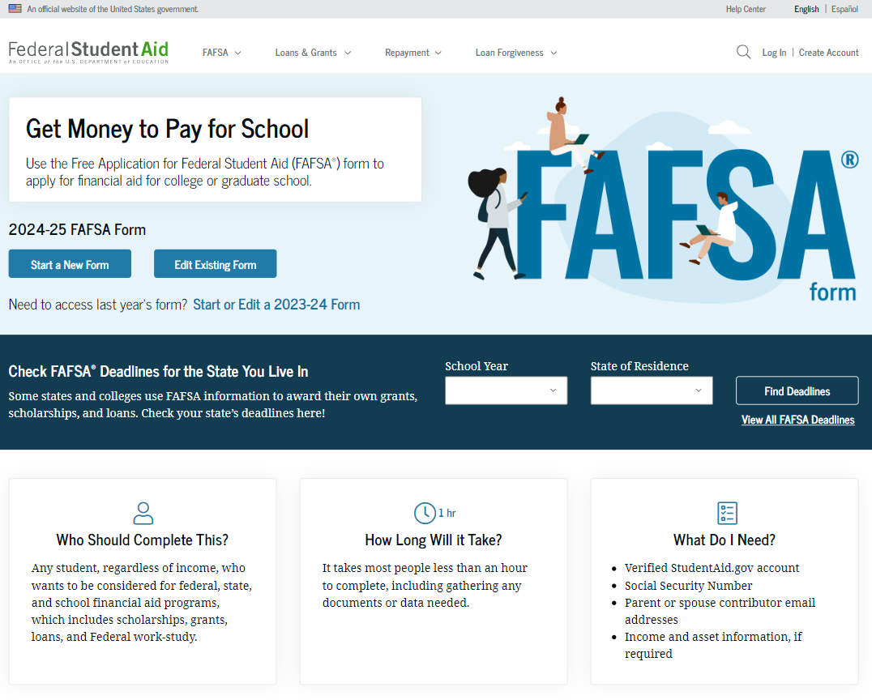
Studentaid.gov

Slide 5
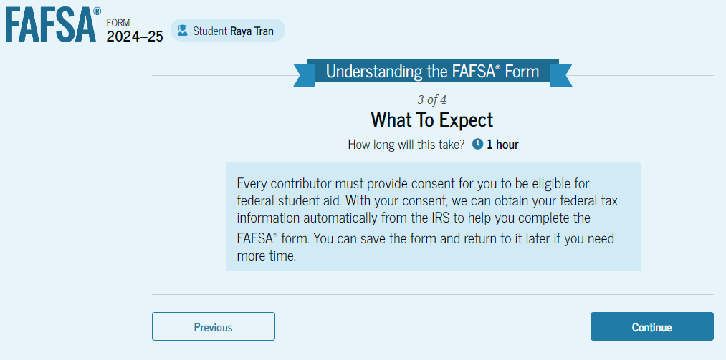
All contributors provide consent for the Direct Data Exchange (FA-DDX)

Slide 6
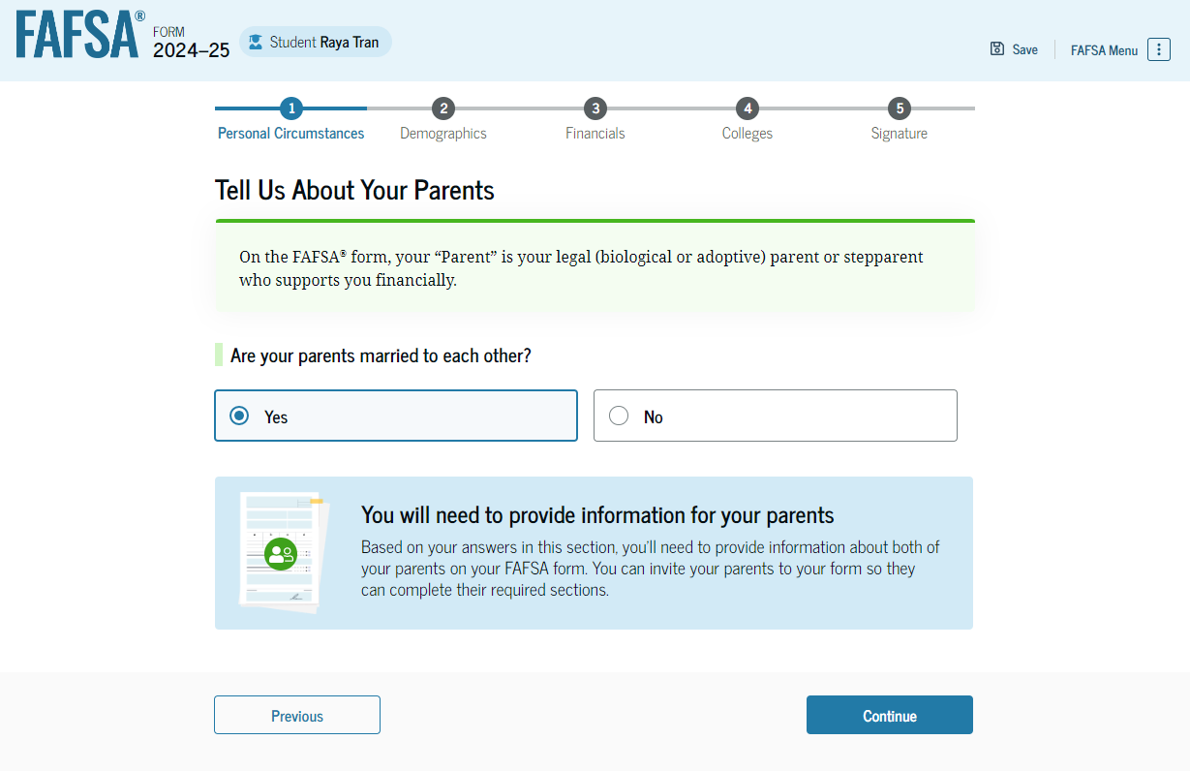
Dependent students are asked to provide information about their parents. The FAFSA® form considers their “Parent” to be their legal (biological or adoptive) parent. The student is asked if their parents are married. The student selects "Yes" and is required to invite their parents to their FAFSA form to complete the required parent sections.
‹#›

Slide 7
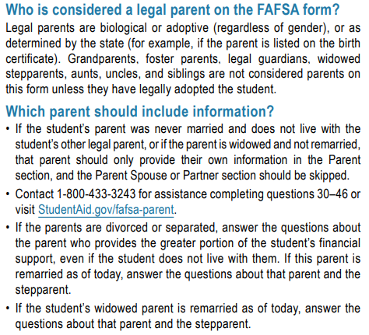
‹#›

Slide 8
FAFSA Family Size?
Student
Student’s parent who provides the majority of the financial support and that parent’s spouse or partner
The parent’s dependent children (even if they live apart because of college enrollment) only if the parent will provide more than half of their support between July 1, 2024, and June 30, 2025.
Other people living with the parent now, only if the parent will provide more than half of their support between July 1, 2024, and June 30, 2025.

Slide 9
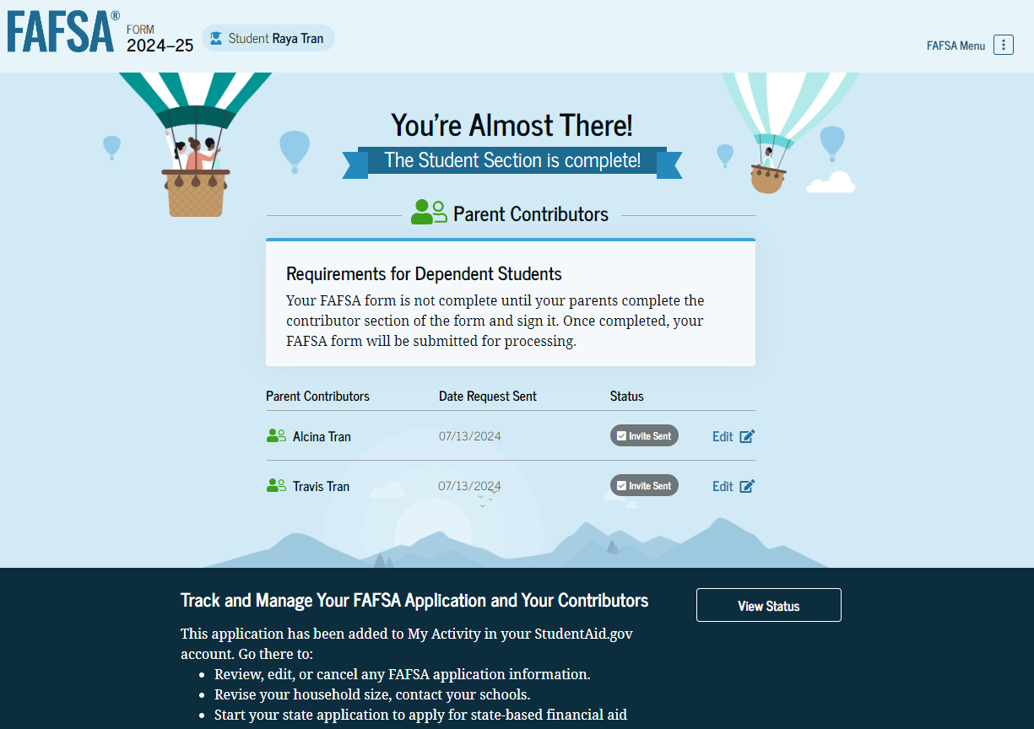

Slide 10
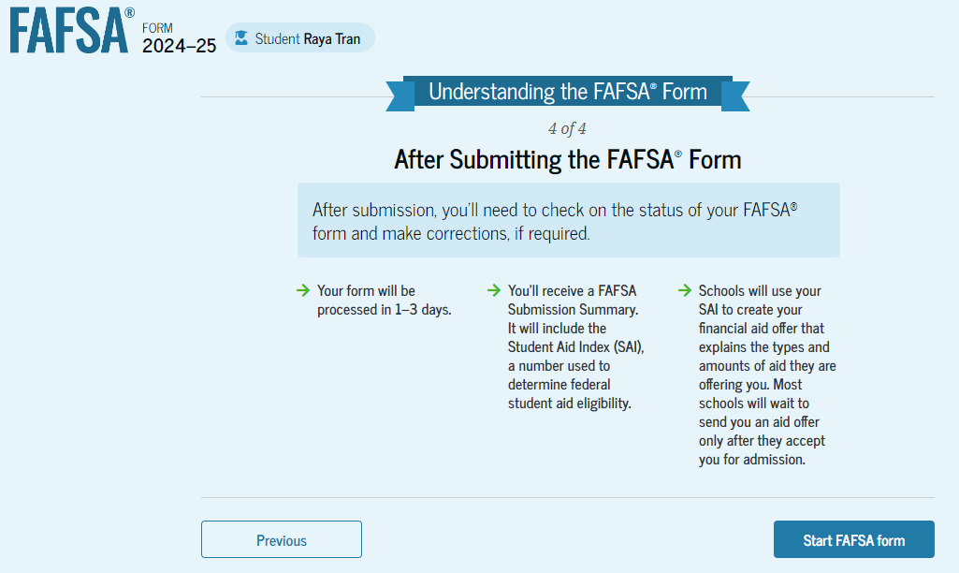

Slide 11
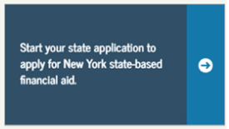
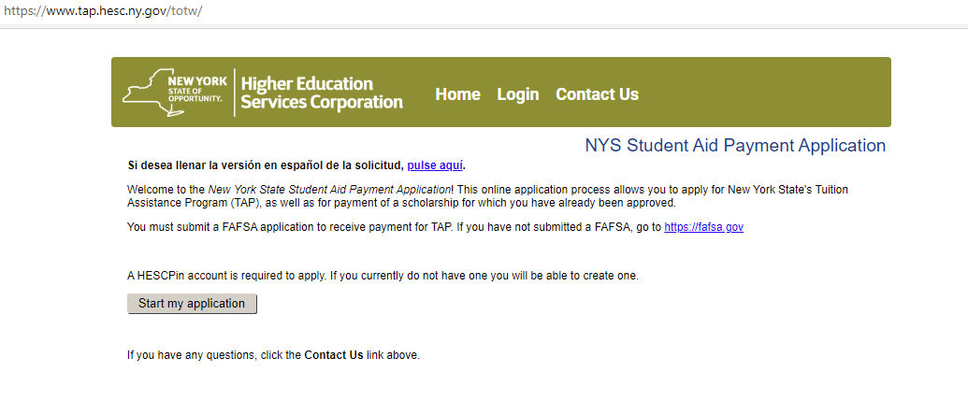
Access the NYS Payment Application (TAP app) via the link from the FAFSA confirmation page,
or visit HESC directly.

Slide 12
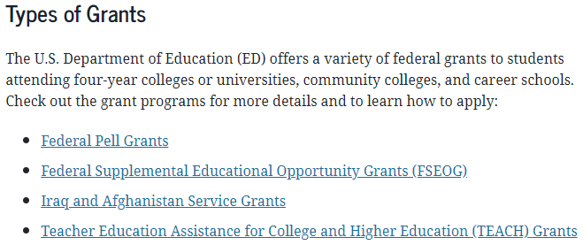
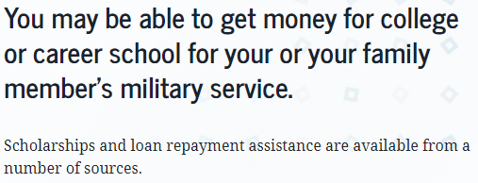
Federal Grants, Work-Study and Aid for Military Families

Slide 13
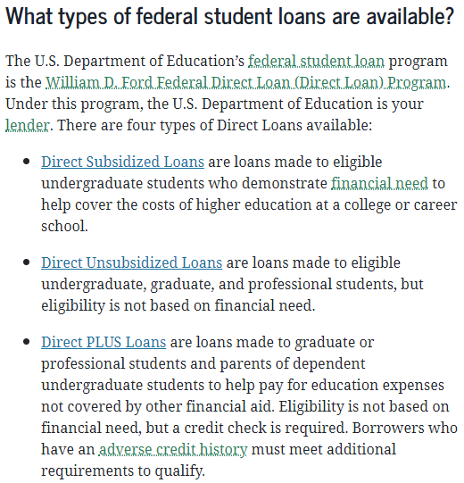
Interest is not charged while in-school, grace or deferment. Interest is charged during repayment.
Eligibility based on calculation of financial need.
LOANS
Interest is charged through the life of the loan (in-school, grace, deferment, forbearance and repayment).
Financial need is not a requirement.
Parent borrower must meet credit, citizenship and non-default criteria.
Amount borrowed cannot exceed the cost of attendance minus other aid.
Interest is charged through the life of the loan.

Slide 14
Maximum Annual Federal Student Loans
Student Level Base Sub/Unsub Add’l Unsub Max Annual 1st year undergrad $3,500 + $2,000 $5,500 2nd year undergrad $4,500 + $2,000 $6,500 3rd year undergrad $5,500 + $2,000 $7,500 4th year undergrad $5,500 + $2,000 $7,500
Above amounts are for dependent students. Independent students may receive a larger amount of unsubsidized loan funds.
Dependent students whose parents are ineligible for a PLUS loan may receive additional unsubsidized loan funds.
There are aggregate limits on subsidized and unsubsidized loans as well. Learn more at StudentAid.gov.
LOANS

Slide 15
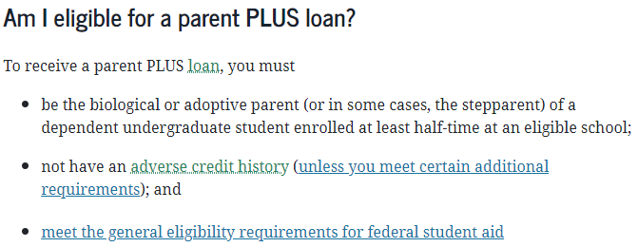
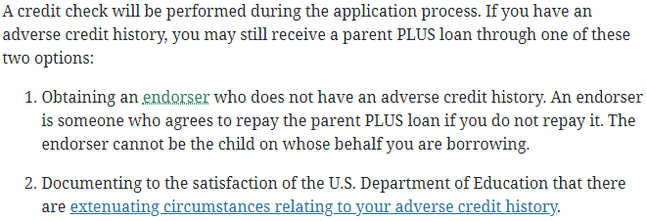
PLUS LOANS

Slide 16
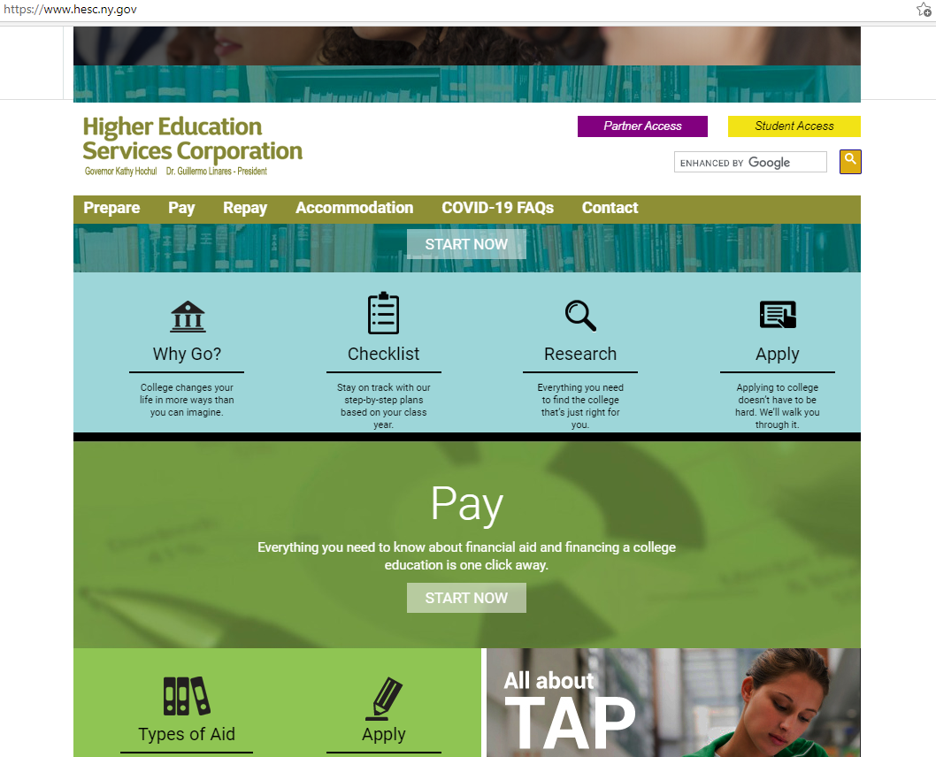

Slide 17
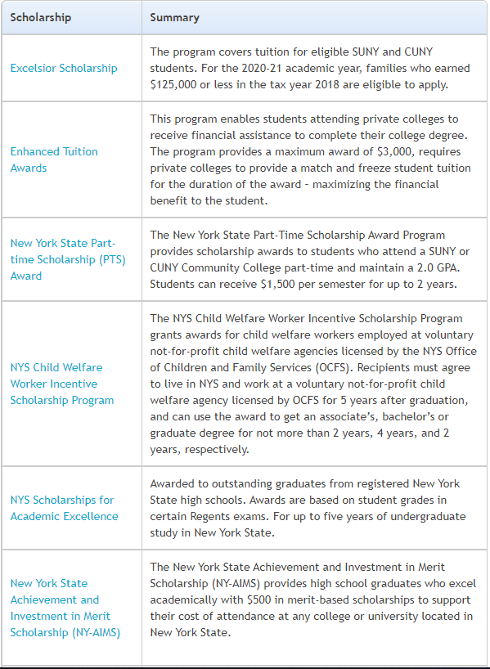
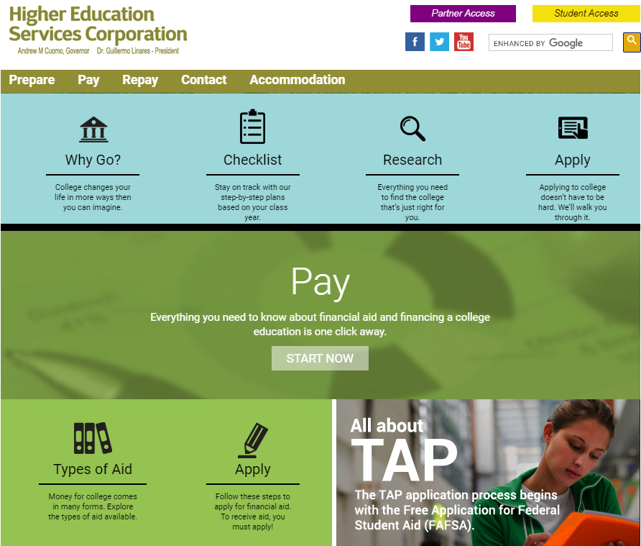
NYS Supported Financial Aid Programs

Slide 18
www.yourcollegewebsite.edu
Learn about applications and deadlines
Explore scholarship opportunities
Online/web access via student portal

Slide 19
External / Private Scholarships and Resources
Online searching:
www.fastweb.com
www.petersons.com
www.collegeboard.org
Also talk with or visit: your school counseling office
your college’s websites
your employers and unions (students and parents)
your community-based organizations and affiliations

Slide 20
Receiving And Reviewing My Award Packages
Complete the FAFSA and TAP applications, others as advised by your college
Receive your award notices
Review your awards and compare your offers
Respond to requests for additional information and documentation
MOST often notifications are sent to the student, likely via email or web portal

Slide 21
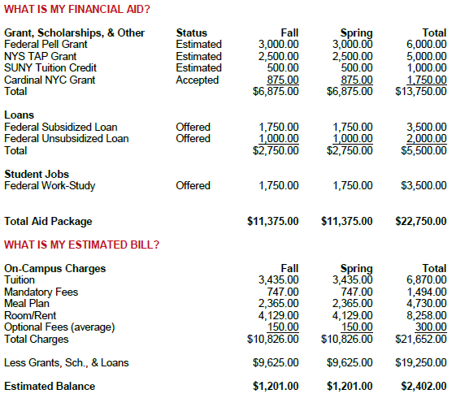
Review and compare your financial aid award letters

Slide 22
How much does my college cost?
What criteria must I meet to receive the award?
What if my financial circumstances have changed?
???
Is the award renewable?
Will I be able to afford loan repayment after college?
Are jobs by placement or competitive?
Am I willing to borrow to help pay for college?
How will a private scholarship affect my award package?
What if the aid I am offered is not enough?

Slide 23
Contact your financial aid department
How will I pay for college?
Payment Plans (college specific using personal resources)
Federal Student Loans (subsidized and unsubsidized)
Federal PLUS Loans (a parent is the borrower)
Private Student Loans (thru an independent bank or lender)
College Costs
Financial Aid
= What You Pay
What if I have special or changed circumstances?
I don’t live with a parent
Changes in family income (e.g. job loss, retirement, income reduction)
Changes in parent marital status (e.g. separation, divorce, death)
Dissolution of family unit (e.g. abuse, neglect or abandonment)

Slide 24
Ask for help with:
Application questions
Explaining your award package
Loan and paying options
Special circumstances (financial changes or hardships)
Kerry Lubold
luboldkl@plattsburgh.edu
(518) 564-2072

